Slide 1
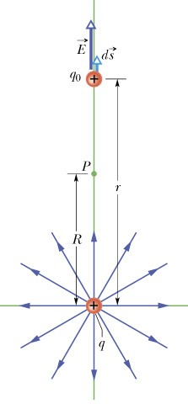

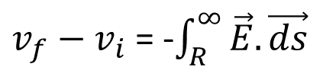
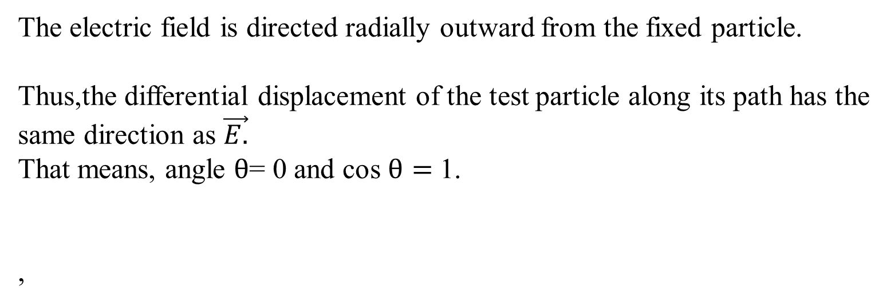
POTENTIAL DUE TO POINT CHARGE
Consider a point P at distance R from a fixed particle of positive charge
imagine that we move a positive test charge q₀ from point P to infinity .
Because the path we take does not matter, let us choose the simplest one— a line that extends radially from the fixed particle through P to infinity.
$$\vec{E}. \vec{ds}=Ecosθ ds$$
The electric field is directed radially outward from the fixed particle.
Thus,the differential displacement of the test particle along its path has the same direction as $\vec{E.}$
That means, angle $θ$= 0 and cos $θ=$ 1.
,
$v_{f}−v_{i}$ = -$\int_{R}^{∞}{\vec{E}.\vec{ds}}$

Slide 2
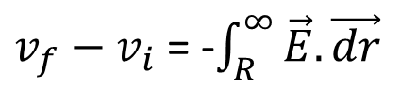
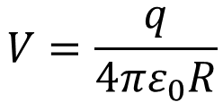

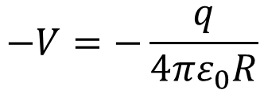
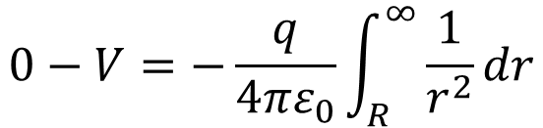
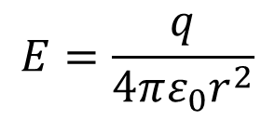
POTENTIAL DUE TO POINT CHARGE
Let us write ds as dr.
Substituting the limits Rand $∞$, we can write
$v_{f}−v_{i}$ = -$\int_{R}^{∞}{\vec{E}.\vec{dr}}$
Let V_{f}= 0 at infinity and V_{i} = V(At R).
Then, for the magnitude of the electric field at the site of the test charge is given by
$$E=\frac{q}{4πε_{0}r^{2}}$$
$$0−V=−\frac{q}{4πε_{0}}\int_{R}^{∞}{\frac{1}{r^{2}}dr}$$
$$−V=−\frac{q}{4πε_{0}R}$$
$$V=\frac{q}{4πε_{0}R}$$
Potential due to a point charge

Slide 3



POTENTIAL DUE TO GROUP OF POINT CHARGE
q₁
Consider the group of three point charges shown in the figure. The potentival V generated by this group of n charges at point P is calculated using the principle of superposition.
r₁
q₂
r₂
r₃
q
1. We determine the potentials V₁ ,V₂ , and V₃ generated
3
by each charge at point P:
V = V₁ + V₂ + V
1 1 1 q₃
4πε r
3
V =
^{q1} , V = ^{q2} , V =
1
2 3
4πε r 4πε r
0 1 0 2
0 3
2. We add the three terms:
V = V₁ + V₂ + V₃
1 q₁ 1 q₂
V =
1 q₃
4πε₀ r₁ 4πε₀ r₂ 4πε₀ r₃
+ +
The previous equation can be generalized for n charges as follows:
1 q 1 q 1 q_{n}
4πε₀
1 q_{i}
4πε₀ r_{i}
n
V =
1
+ ² + ... + =
∑
1
r₁ 4πε₀ r₂
4πε₀ r_{n}

Slide 4
.P
POTENTIAL DUE TO CONTINUOUS DISTRIBUTION OF CHARGES
Consider the charge distribution shown in the figure. In order to determine the electric potential V created by the distribution at point P we use the principle of superposition as follows:
1. We divide the distribution into elements of charge dq. For a volume charge distribution, dq = ρdV .
For a surface charge distribution, dq = σ dA. For a linear charge distribution, dq = λdI.
r
dq
1 dq
V = ∫
4πε r
0
1 dq .
2. We determine the potential dV created by dq at P: dV =
4πε₀ r
_{V =} 1 ∫ dq.
3. We sum all the contributions in the form of the integral:
4πε₀ r
Note 1 : The integral is taken over the whole charge distribution.
Note 2 : The integral involves only scalar quantities.

Slide 5
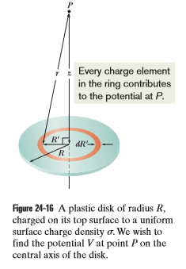
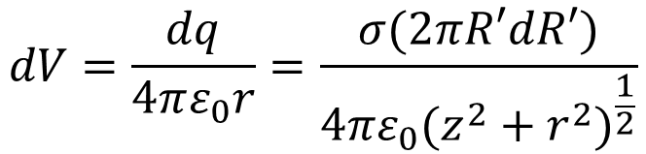
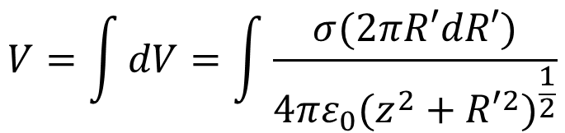
Potential due to a charged disk
We calculated the magnitude of the electric field at points on the central axis of a plastic disk of radius R that has a uniform charge density on one surface.
Here we derive an expression for V(z), the electric potential at any point on the central axis.
Because we have a circular distribution of charge on the disk, we could start with a differential element that occupies angle dθ and radial distance dr.
dq = σ dA = σ (2π R’dR’).
$$dV=\frac{dq}{4πε_{0}r}=\frac{σ(2πR′dR′)}{4πε_{0}{(z^{2}+r^{2})}^{\frac{1}{2}}}$$
$$V=\int{dV}=\int{\frac{σ(2πR′dR′)}{4πε_{0}{(z^{2}+{R′}^{2})}^{\frac{1}{2}}}}$$

Slide 6
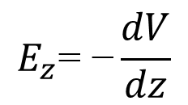
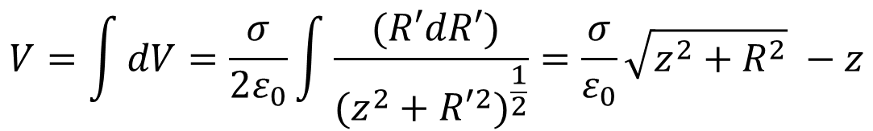
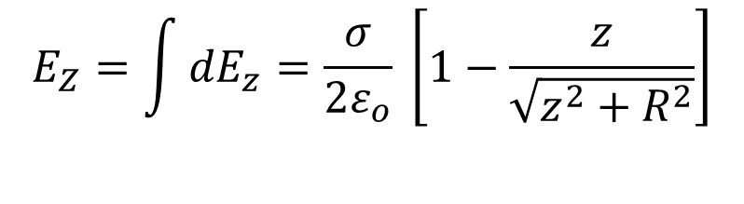
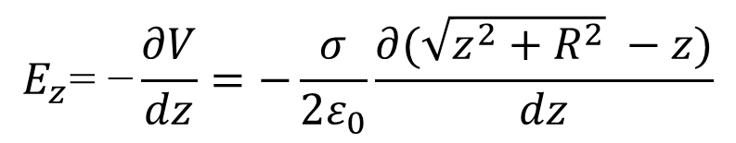
Potential due to a charged disk
$$V=\int{dV}=\frac{σ}{{2ε}_{0}}\int{\frac{ (R′dR′)}{{(z^{2}+{R′}^{2})}^{\frac{1}{2}}}=\frac{σ}{ε_{0}}\sqrt{z^{2}+R^{2}} −z}$$
The electric potential at any point on
the central axis of a uniformly charged
disk
Finding the field from the potential
$$E_{z}\text{= }\text{−}\frac{dV}{dz}$$
$$E_{z}\text{= }\text{−}\frac{∂V}{dz}=−\frac{σ}{{2ε}_{0}}\frac{∂(\sqrt{z^{2}+R^{2}} −z)}{dz}$$
$$E_{Z}=\int{{dE}_{z}}=\frac{σ}{2ε_{o}} \left[1−\frac{z}{\sqrt{z^{2}+R^{2}}}\right]$$
Same as the electric field calculated from
coulombs law

Slide 7
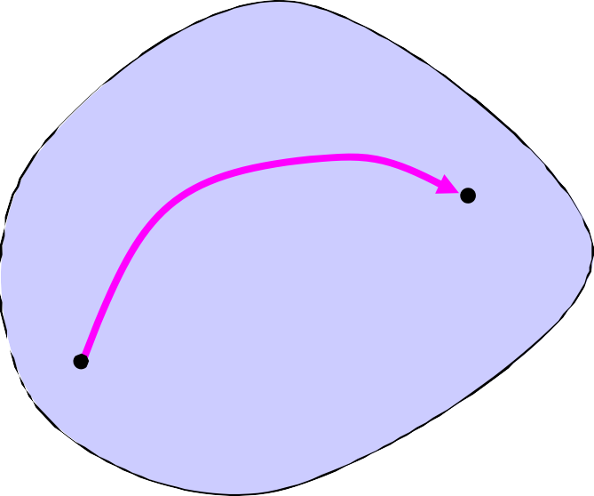
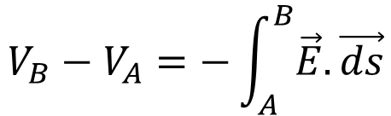
POTENTIAL OF AN ISOLATED CONDUCTOR
Consider two points A and B on or inside a conductor. The potential difference V_{B} −V_{A} between these two points is given by the equation:
path
conductor
B
A
E = 0
$$V_{B}−V_{A}=−\int_{A}^{B}{\vec{E}.\vec{ds}}$$
The electrostatic field inside a conductor is zero.
Thus the integral above vanishes, and V_{B} = V_{A} for any two points on or inside the conductor.
A conductor is an equipotential surface.

Slide 8
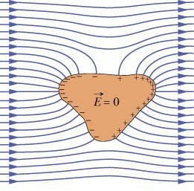
ISOLATED CONDUCTOR IN AN EXTERNAL ELECTRIC FIELD

Slide 9
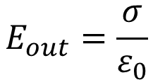
The surface of a conductor is an equipotential surface.
ISOLATED CONDUCTOR IN AN EXTERNAL ELECTRIC FIELD
The electric field lines are perpendicular to the equipotential surfaces.
All the charges of the conductor reside on the surface and arrange themselves in such a way so that the net electric field inside the conductor E_{in} = 0.
The electric field just outside the conductor is:
$$E_{out}=\frac{σ}{ε_{0}}$$

Slide 10
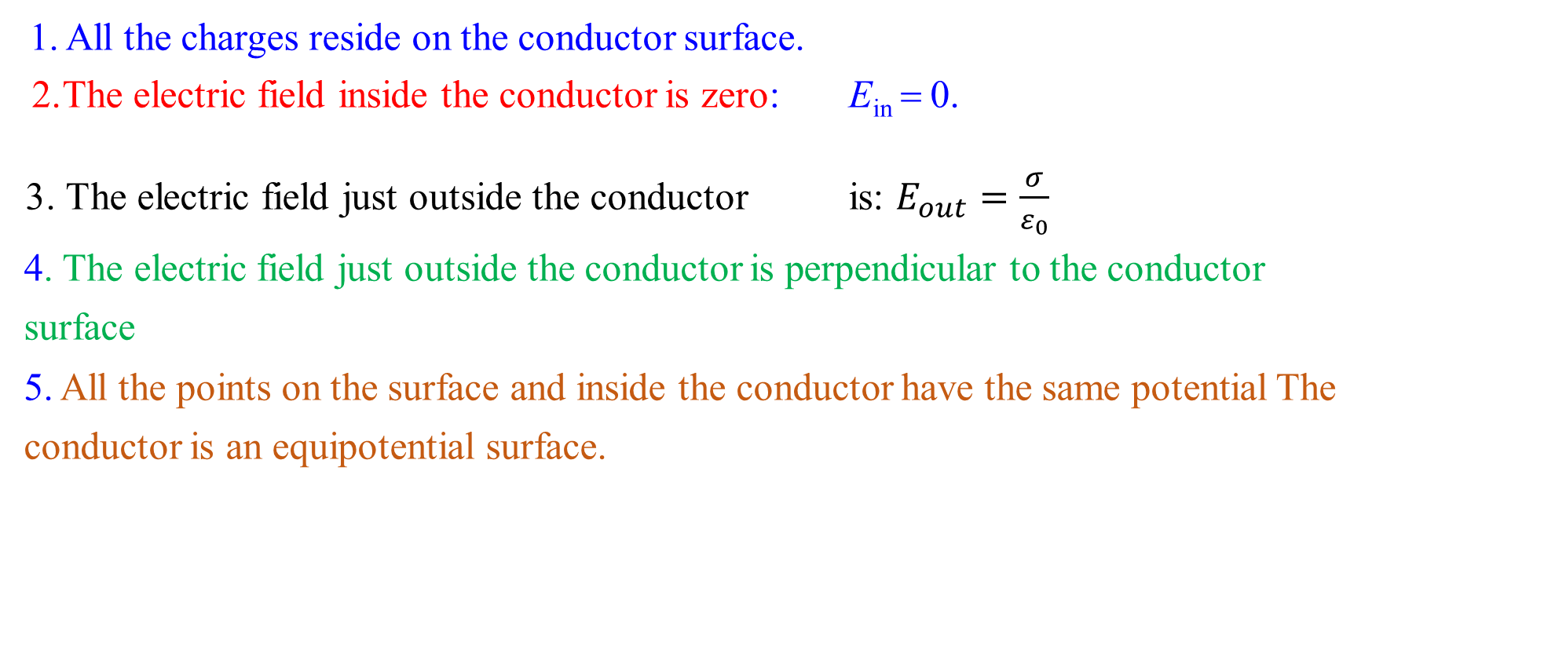
PROPERTIES OF A CONDUCTOR – A SUMMARY
❒
E
nˆ
❒
σ
ε₀
^{E}out ⁼
nˆ
❒
E
E_{in} = 0
All the charges reside on the conductor surface.
The electric field inside the conductor is zero: E_{in} = 0.
3. The electric field just outside the conductor is: $E_{out}=\frac{σ}{ε_{0}}$
4. The electric field just outside the conductor is perpendicular to the conductor surface
5. All the points on the surface and inside the conductor have the same potential The conductor is an equipotential surface.
0

Slide 11
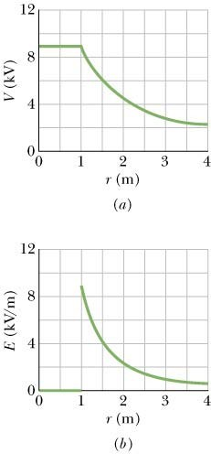
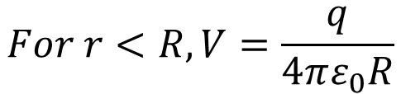
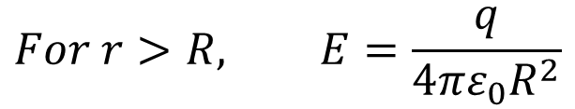

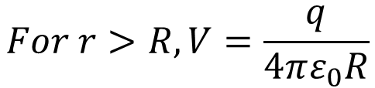
Electric Field and Electric Potential for a Spherical Conductor
$$For r<R, V=\frac{q}{4πε_{0}R}$$
$$For r>R, V=\frac{q}{4πε_{0}R}$$
$$For r<R, E=0$$
$$For r>R, E=\frac{q}{4πε_{0}R^{2}}$$
R
Note : Outside the spherical conductor, the electric field and the electric potential are identical to that of a point charge equal to the net conductor charge and placed at the center of the sphere.

